Slide 1
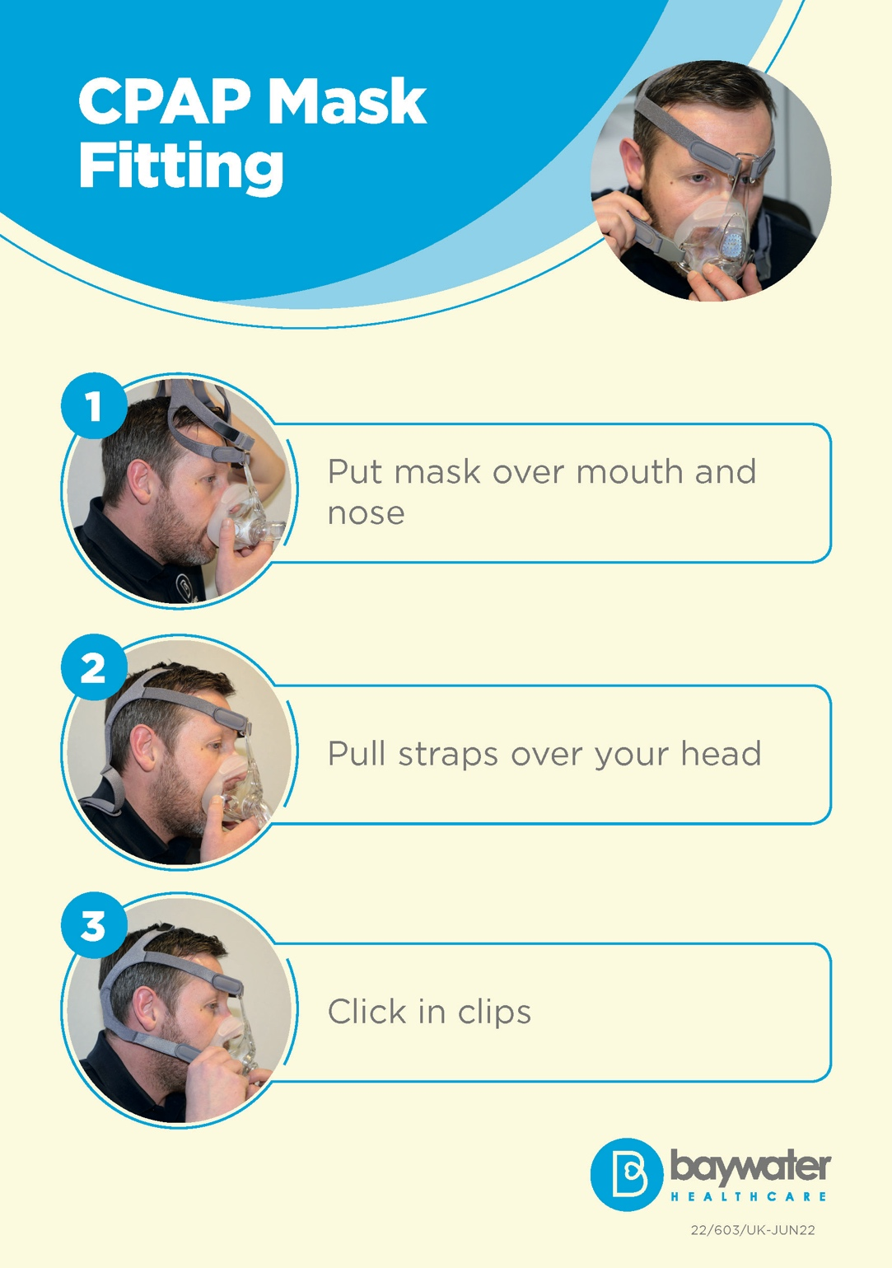
The CPAP Sleep Apnoea Project
Aim to develop the right kind of information about sleep apnoea and CPAP
Understand what support people with a learning disability and autistic people may need
Discover issues with using CPAP equipment
Hear about problems people encounter
Co-Produce helpful resources such as leaflets, videos, guidance

Slide 2
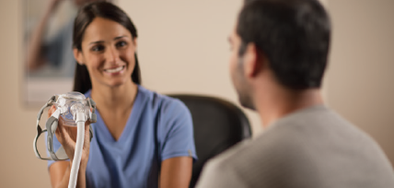
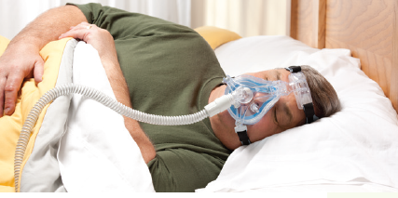
Discover the issues
Find out issues with people using CPAP machines effectively.
We will speak to people who help with CPAP machines
We will speak to people who use CPAP machines

Slide 3
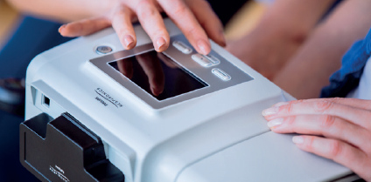
Discovery
We will find out if people have the skills and knowledge needed on CPAP machines.
We will speak to people who care & support people with CPAP machines

Slide 4
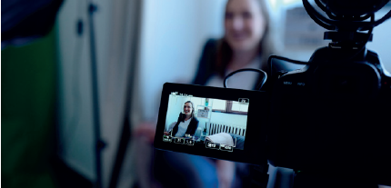
Co-Produce & Develop Helpful guides
We will develop guides to help solve issues people have told us about
We will co-produce and involve people so the guides work for them.

Slide 5
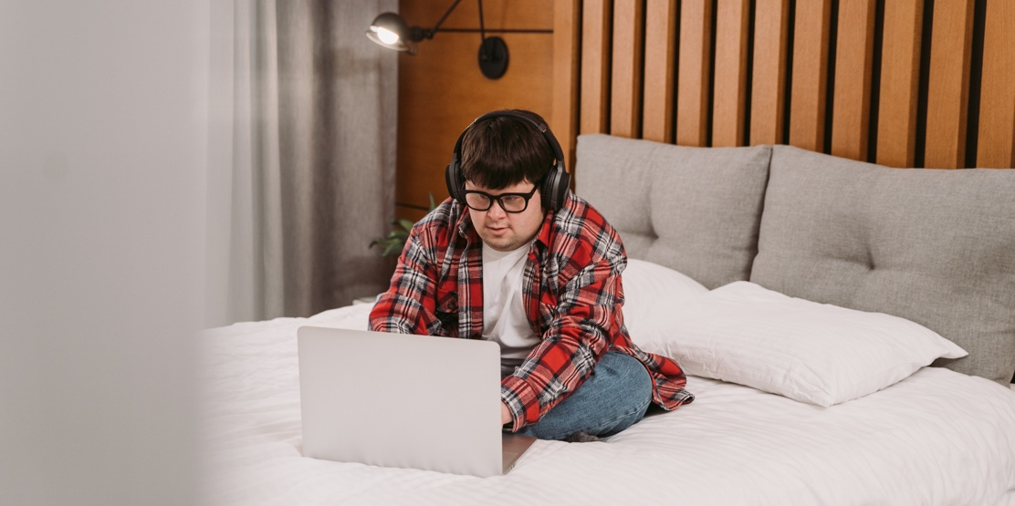
Resources, Videos and Leaflets
We will start to make leaflets, take pictures & videos
We will write CPAP machine booklets
We will share new videos, booklets and leaflets and ask people who have experience

Slide 6
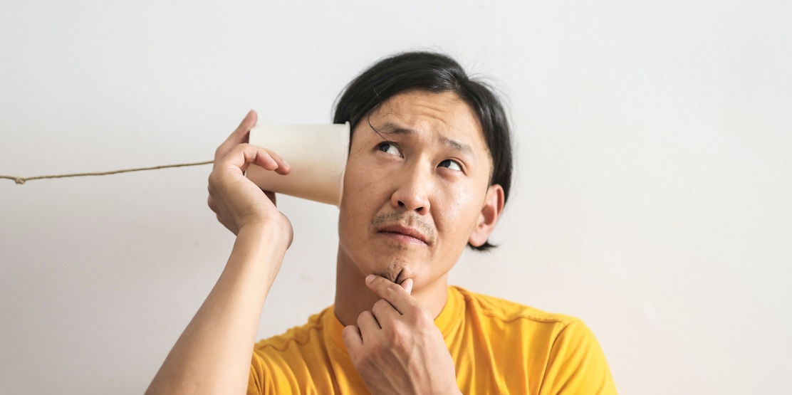
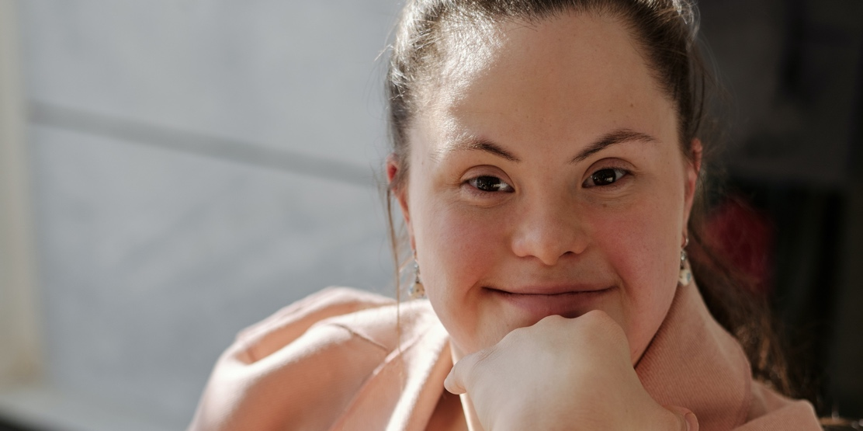
Checking what works
We will listen to what people say
We will make sure people find them useful and are happy
Want to find out more & help?
Click on this link: https://forms.gle/UpqfHNZ1d3mGWiFZA
We can arrange to meet online in a group or complete a survey

